Slide 1
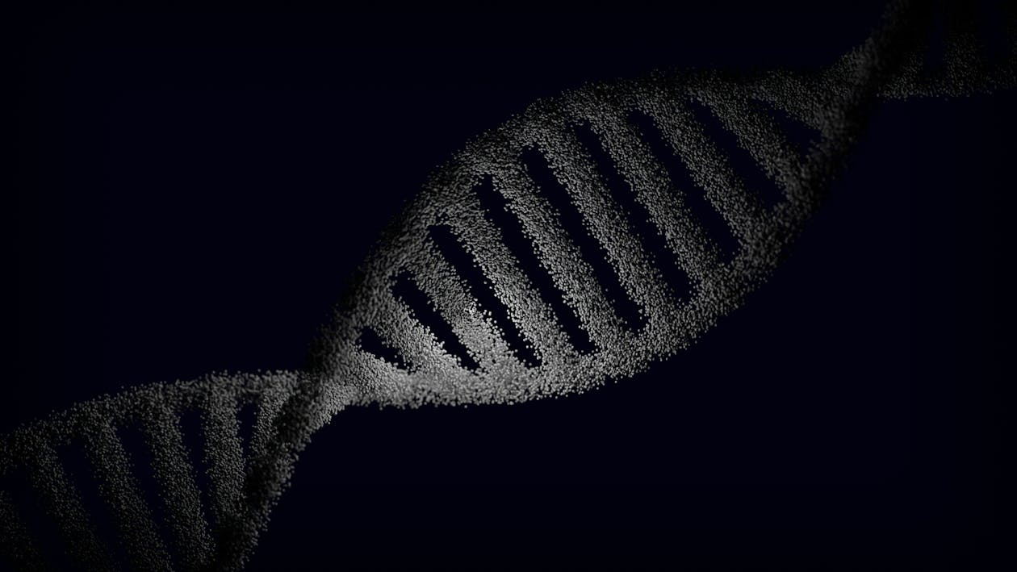
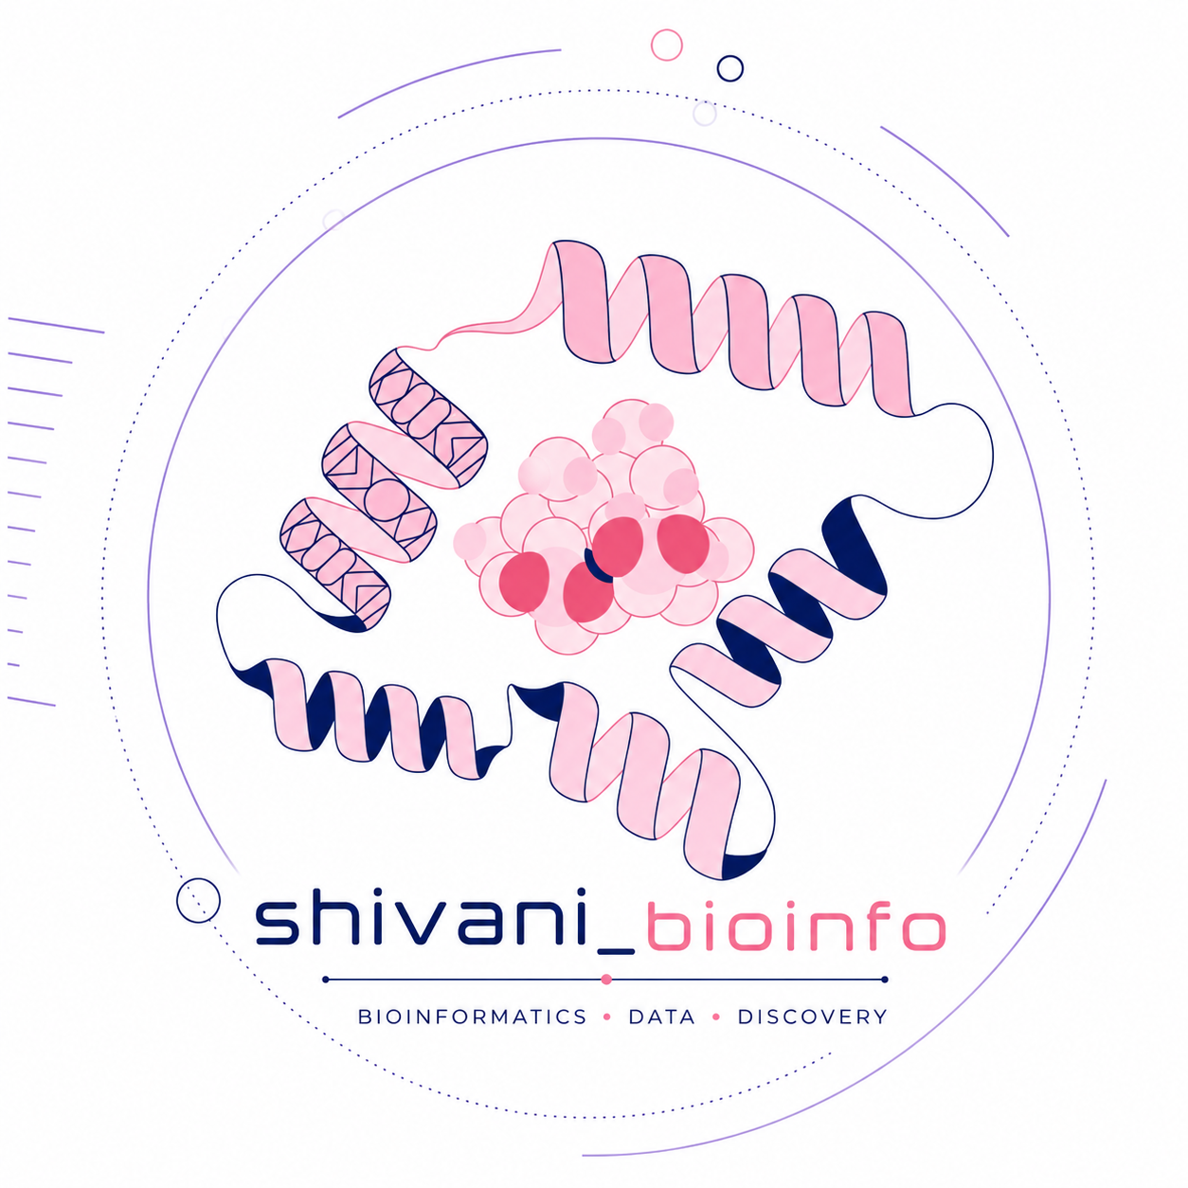
Introduction to Bioinformatics for Life Sciences
Role of Computational Biology in Modern Research
Hosted by Shivani_Bioinfo
Presentor: Shivani V. Pawar Bioinformatics Researcher | Computational Biologist | Founder, Bioinfo_Shivani
📅 6 June 2026 🕒 7:00 PM IST 💻 Online Webinar

Slide 2
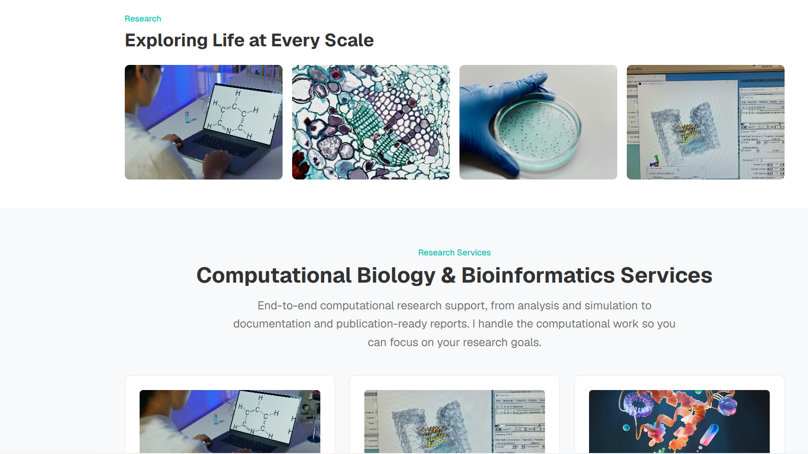
Welcome to Shivani_Bioinfo
Bioinfo_Shivani was created with the vision of making bioinformatics accessible, practical, and impactful for students, researchers, and professionals.
The platform focuses on:
✅ Bioinformatics education and training
✅ Research guidance and mentorship
✅ Workshops and webinars
✅ Career development in computational biology
✅ Building a collaborative scientific community

Slide 3

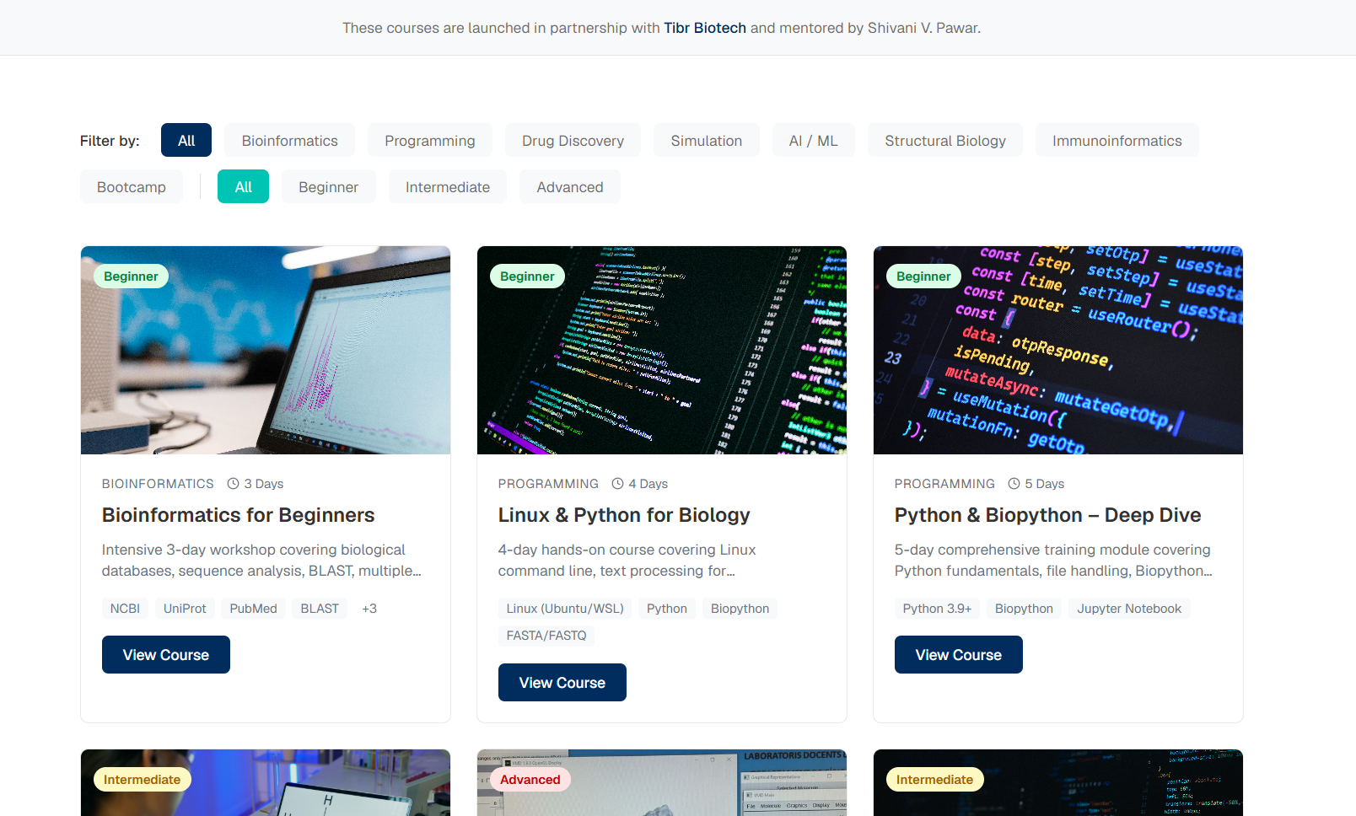
Welcome to Shivani_Bioinfo

Slide 4

Bioinformatics
The Computational Architecture of Biological Systems
SYNTHESIZED TECHNICAL OVERVIEW

Slide 5
Module
Fundamentals & Core Definitions

Slide 6






Definition & Interdisciplinary Scope
Biological Inquiry
Computational Logic
Statistical Rigor
Decoding the Central Dogma (DNA → RNA → Protein) using high-throughput sequencing technologies.
Applying Bayesian Inference and Hidden Markov Models (HMM) to distinguish signal from biological noise.
Implementing Dynamic Programming algorithms (e.g., Smith-Waterman) for sequence alignment.

Slide 7

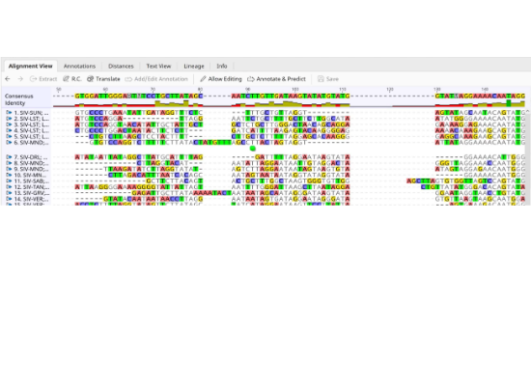
History & Evolution
The field originated in the 1960s with Margaret Dayhoff, who pioneered protein sequence alignment and the Point Accepted Mutation (PAM) matrix.
▪
1970s: Needleman-Wunsch global alignment algorithm.
▪
1990s: Launch of the Human Genome Project (HGP).
▪
2000s: Next-Generation Sequencing (NGS) era begins.
▪
Today: Multi-omics integration and Big Data.

Slide 8
Module 3
Advanced Computational Areas

Slide 9
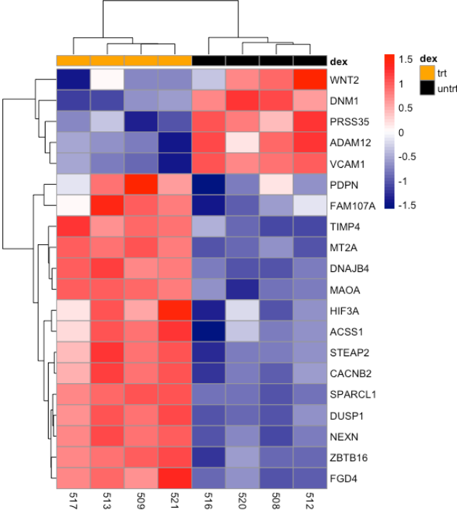


Transcriptomics
Quantitative analysis of the Transcriptome—the complete set of RNA transcripts produced by the genome under specific conditions.
Utilizing RNA-Seq to determine differential gene expression. This process relies on calculating normalized values such as TPM (Transcripts Per Million).

Slide 10

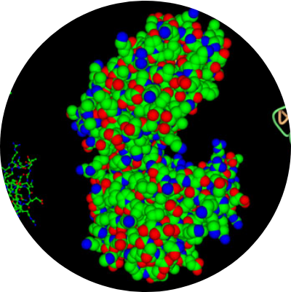
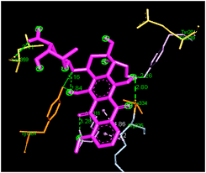
Structural Bioinformatics
Molecular Docking
Predicting the preferred orientation of one molecule to a second when bound to each other to form a stable complex.
Essential for Rational Drug Discovery, where computational scoring functions estimate binding affinity and stability.

Slide 11

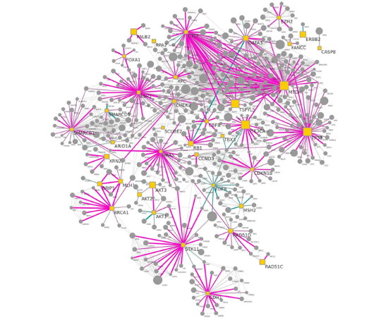
Systems Biology & AI
Biological Networks
Moving from reductionist analysis to holistic modeling of interaction networks (PPIs, Metabolic pathways).
AlphaFold & ML: Modern Deep Learning architectures are solving the 50-year-old protein folding problem with unprecedented accuracy.

Slide 12
Module 4
Data Infrastructure & Access

Slide 13
Critical Biological Repositories
Infrastructure | Core Repository | Biological Target | Standard Format
NCBI | GenBank / RefSeq | Nucleotide / Genomic | FASTA / GenBank
UniProt | Swiss-Prot / TrEMBL | Protein Sequence | Flat File / XML
RCSB PDB | Protein Data Bank | 3D Macromolecules | PDB / mmCIF
EMBL-EBI | ENA | Raw Sequencing Data | FASTQ
*Programmatic access typically via REST APIs or specialized toolsets like BioPython/BioPerl.

Slide 14



Emerging Applications
Precision Medicine
Agri-Genomics
Synthetic Biology
Pharmacogenomics-based therapy selection to minimize adverse drug reactions.
Marker-Assisted Selection (MAS) for drought-resistant and nutrient-dense crops.
CAD-based design of metabolic pathways for biofuel production.

Slide 15

Bioinformatics Workflow
Standardizing the Path from Biological Questions to Scientific Publication
Module 6 | Comprehensive Methodology & Case Studies

Slide 16
The Research Lifecycle
An End-to-End Computational Strategy

Slide 17

The 6-Step Standard Workflow
2. Collection
6. Publish
4. Structure
Database Retrieval & Generation
Dissemination & Data Deposit
3D Modeling & Interaction
1. Hypothesis
3. Sequence
5. Function
Biological Question Definition
Alignment & Variant Identification
Pathway & Network Interpretation

Slide 18


Phase 1: Question & Collection
The Biological Question
Data Acquisition
Research begins by identifying a biological gap. Are we looking for the cause of a mutation, the target for a drug, or the evolution of a species?
Data is retrieved from primary databases (NCBI, ENA) or generated via laboratory experiments like Next-Gen Sequencing (NGS).
Example: "Which genetic variants contribute to HER2+ breast cancer drug resistance?"
Quality Control: Essential step to ensure raw data (FASTQ) is clean and reliable for downstream analysis.

Slide 19

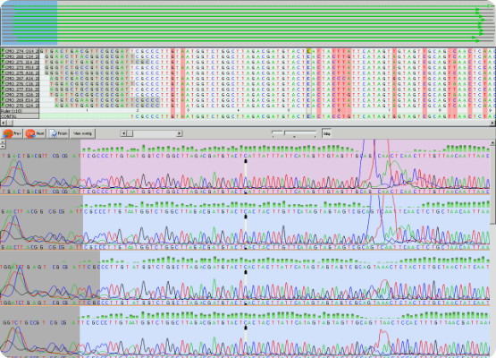
Phase 2: Sequence Analysis
Once data is collected, computational algorithms compare sequences to known references or assemble them de novo.
•
Alignment: Identifying similarities using BLAST or Smith-Waterman.
•
Assembly: Combining overlapping fragments into contiguous sequences.
•
Annotation: Locating genes and functional regions within the sequence.

Slide 20

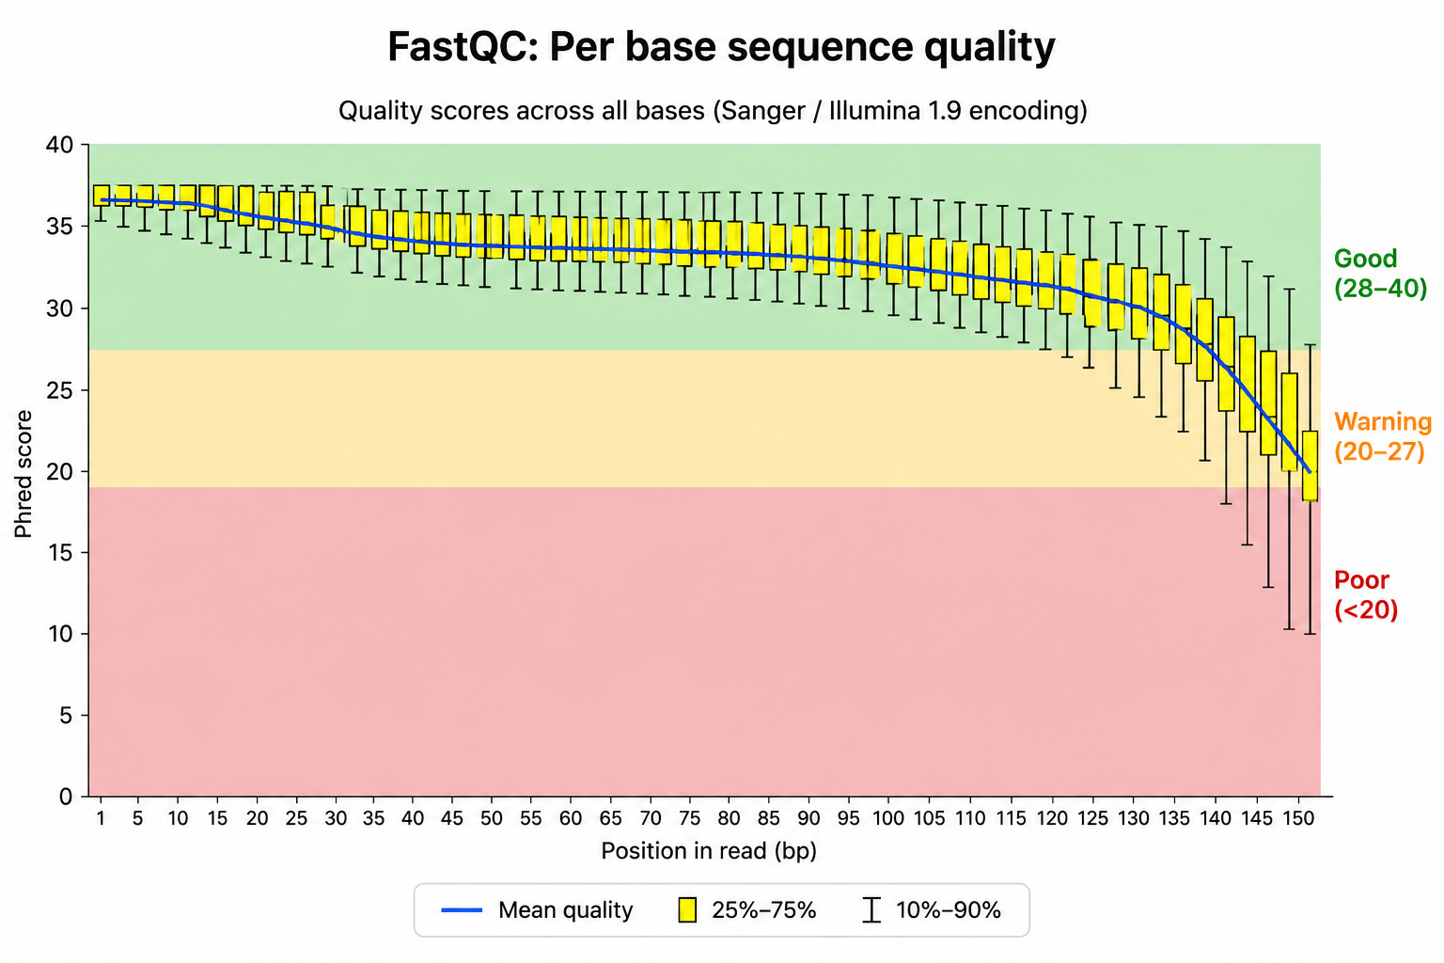


Quality Control & Trimming
Per-Base Quality Evaluation
Using FastQC to analyze sequence-quality distribution along raw reads. Unacceptable drop-offs in Phred scores indicate sequencer issues or base degradation.
Read Filtering: Trimming adapters and low-quality terminals to prevent biased alignments.
We filter out reads that fail to satisfy quality metrics:

Slide 21


Alignment Paradigms
Reference-Based Mapping
De Novo Assembly
Aligning processed fragments directly onto an established, fully assembled target genome sequence.
Reconstructing novel transcriptomes or genomes from scratch without relying on a pre-existing structural blueprint.
Primary Tools: BWA-MEM (Genomic DNA), STAR (Spliced Transcriptome/RNA-Seq), Bowtie2 (Small molecules/Amplicons).
Primary Tools: SPAdes (Bacterial/Viral), Trinity (Transcriptome), Flye (Long-read structural loops).

Slide 22
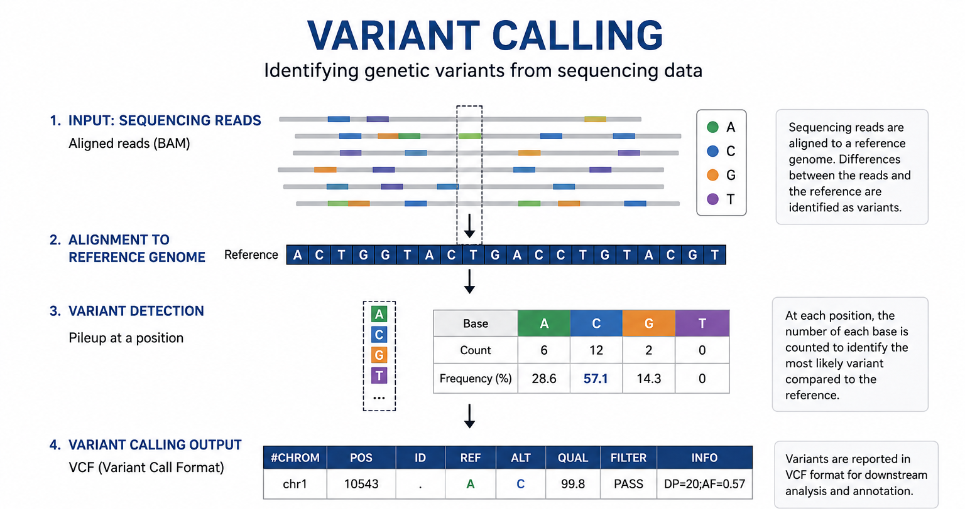
Variant Calling
GATK Pipeline
Processing alignments through GATK Best Practices: sorting reads, marking duplications, performing base quality recalibration (BQSR), and applying HaplotypeCaller to resolve genuine SNPs and small Indels.
Application: Translates raw reads to high-confidence molecular variants.

Slide 23

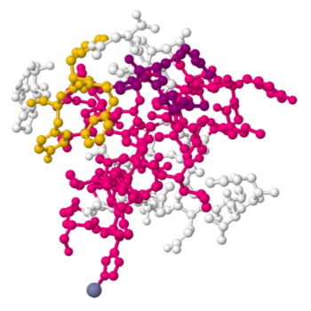
Phase 3: Structural Analysis
3D Molecular Visualization
Bioinformatics transitions from 1D strings to 3D physical models. We predict how proteins fold and how they interact with ligands.
Molecular Docking: Simulates the binding affinity of drug candidates to a protein target. Tools like AutoDock Vina calculate binding energy (ΔG).

Slide 24






Phase 4: Interpretation & Publication
Functional Insight
Validation
Scientific Publication
Mapping genes to biological pathways (KEGG/Reactome) to understand the "Big Picture" of cellular processes.
Bioinformatics results (in silico) are cross-referenced with experimental lab data (in vitro) for confirmation.
Sharing findings via journals and depositing sequences into open-access repositories (GenBank/PDB).

Slide 25
Real Research Examples
Applying the Workflow to Global Challenges

Slide 26
Case Study 1: Disease Research
Workflow Stage | Cancer Research Application (NSCLC) | Bioinformatics Tool Used
Data Collection | Tumor vs. Normal patient biopsy sequencing | Illumina NGS / TCGA Database
Sequence Analysis | Identifying driver mutations (e.g., EGFR) | GATK HaplotypeCaller
Interpretation | Predicting patient response to targeted therapy | COSMIC / Gene Ontology
Result: Identification of unique biomarkers leads to personalized oncology treatment plans.

Slide 27
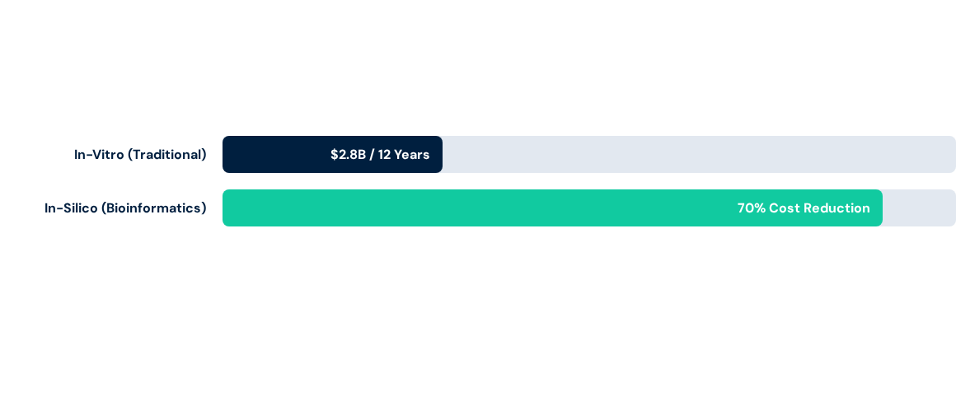
Case Study 2: Drug Discovery Efficiency
Computational pipelines accelerate lead identification from years to weeks.

Slide 28
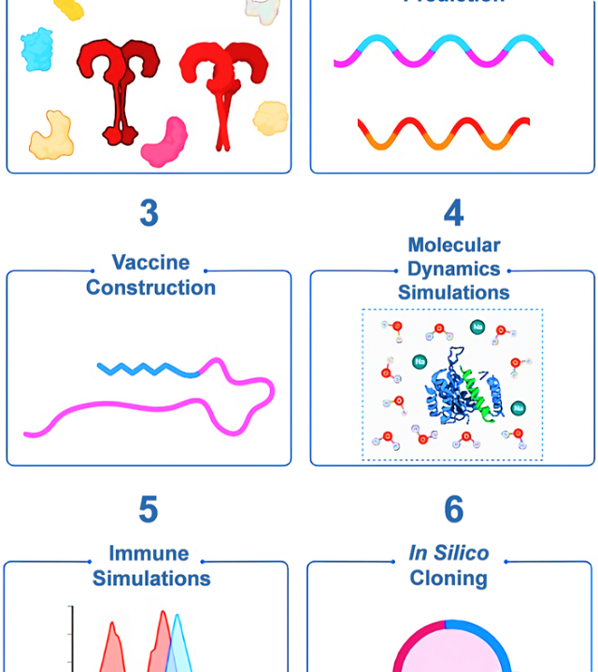
Case 3: Vaccine Design
Reverse Vaccinology: Using bioinformatics to scan entire pathogen genomes for potential vaccine candidates without growing the virus.
During the COVID-19 pandemic, epitope mapping allowed for the rapid design of mRNA vaccines in record time by identifying spike protein regions that trigger the strongest immune response.
•
Sequence surveillance of variants.
•
Structural prediction of protein binding.
•
Population coverage analysis.

Slide 29
Q&A
Synthesis & Critical Inquiries
Access the scientific literature via PubMed for further investigation.
www.ncbi.nlm.nih.gov/pubmed

Slide 30




Image Sources
https://images.ctfassets.net/ifq1osqu2ba1/4tqNiGRHr6Kvy98mWneyHE/5e996930c7b7e5c56d55f201f06bd7a0/alignment.png
Source: www.geneious.com
https://bioinformatics.ccr.cancer.gov/docs/data-visualization-with-r/images/pheatmap_airway.png
Source: bioinformatics.ccr.cancer.gov
https://cdn.rcsb.org/rcsb-pdb/content/69d556066c4fcd38cafe9464/3pgk-representations.jpg
Source: pdb101.rcsb.org
https://journals.plos.org/ploscompbiol/article/figure/image?size=medium&id=10.1371/journal.pcbi.1010205.g001
Source: journals.plos.org

